Slide 1
JAVA IO Packages
Rima Patel

Slide 2
Streams & Files
The objectives of this chapter are:
To understand the principles of I/O streams and where to use them
To understand the options and limitations of I/O streams
To become comfortable with the mechanisms for accessing the file system

Slide 3
Introduction
So far we have used variables and arrays for storing data inside the programs.
This approach poses the following limitations:

Slide 4
Limitation
The data is lost when variable goes out of scope or when the program terminates. That is data is stored in temporary/mail memory is released when program terminates.
It is difficult to handle large volumes of data.

Slide 5
Solution
We can overcome this problem by storing data on secondary storage devices such as floppy or hard disks.
The data is stored in these devices using the concept of Files and such data is often called persistent data.

Slide 6
File Processing
Storing and manipulating data using files is known as file processing.
Reading/Writing of data in a file can be performed at the level of bytes, characters, or fields depending on application requirements.
Java also provides capabilities to read and write class objects directly. The process of reading and writing objects is called object serialisation.

Slide 7
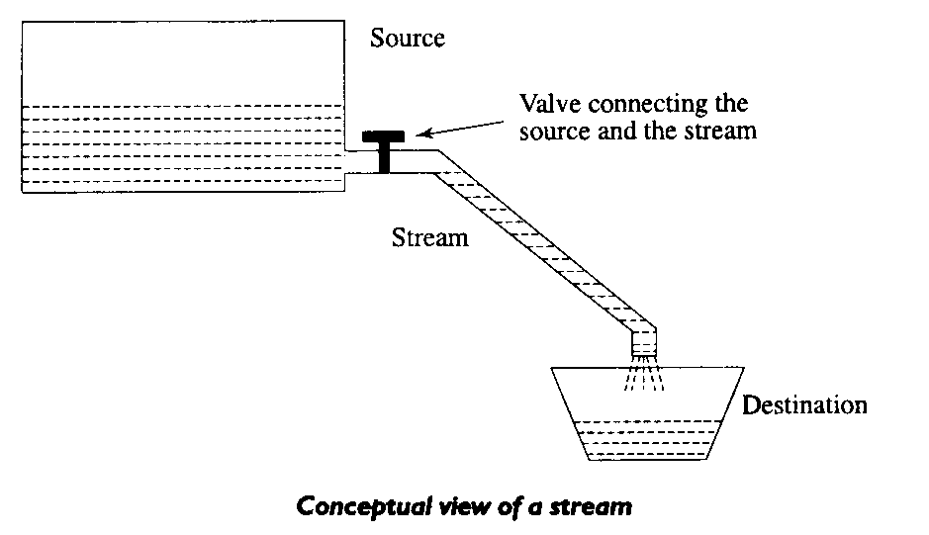
Streams
Java Uses the concept of Streams to represent the ordered sequence of data, a common characteristic shared by all I/O devices.
Streams presents a uniform, easy to use, object oriented interface between the program and I/O devices.
A stream in Java is a path along which data flows (like a river or pipe along which water flows).

Slide 8
Stream Types
The concepts of sending data from one stream to another (like a pipe feeding into another pipe) has made streams powerful tool for file processing.
Connecting streams can also act as filters.
Streams are classified into two basic types:
Input Steam
Output Stream
Input Stream
reads
Source
Program
Output Stream
Program
Source
writes

Slide 9
Java Stream Classes
Input/Output related classes are defined in java.io package.
Input/Output in Java is defined in terms of streams.
A stream is a sequence of data, of no particular length.
Java classes can be categorised into two groups based on the data type one which they operate:
Byte streams
Character Streams

Slide 10
Streams
Byte Streams | Character streams
Operated on 8 bit (1 byte) data. | Operates on 16-bit (2 byte) unicode characters.
Input streams/Output streams | Readers/ Writers

Slide 11
Example: Fileoutputstream
import java.io.FileOutputStream;
public class FileOutputStreamExample {
public static void main(String args[]){
try{
FileOutputStream fout=new FileOutputStream("D:\\testout.txt");
fout.write(65); // used to write the specified byte to the file output stream.
fout.close(); // used to closes the file output stream.
System.out.println("success...");
}catch(Exception e){System.out.println(e);}
}
}

Slide 12
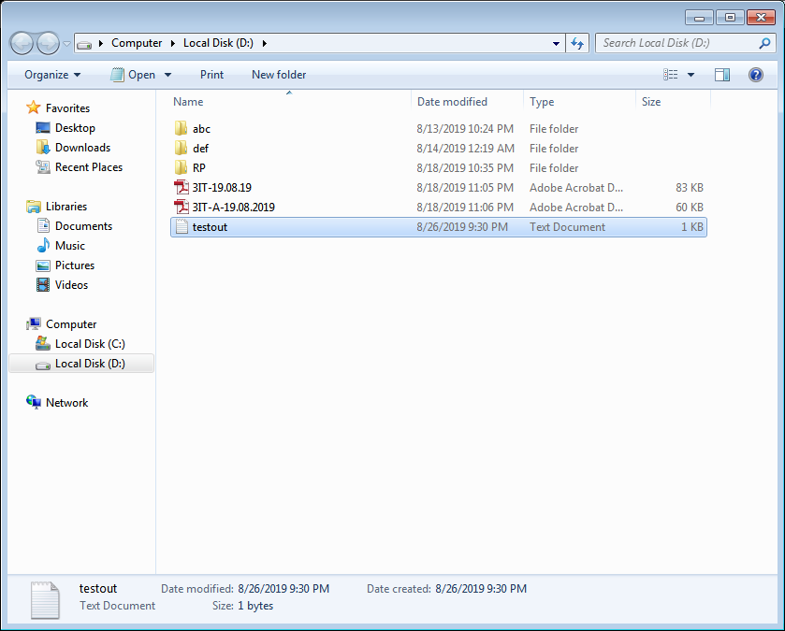

Slide 13
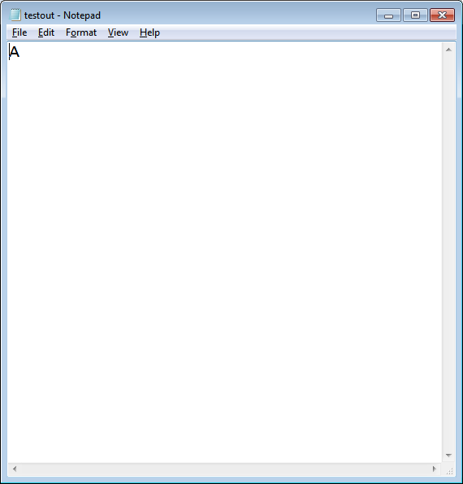

Slide 14
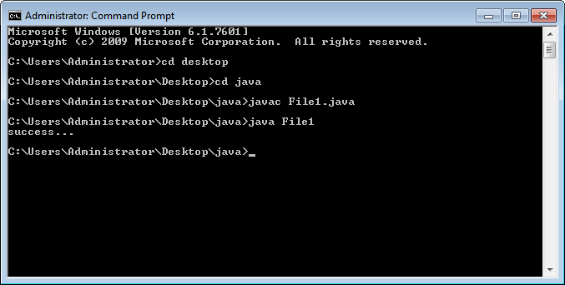

Slide 15
import java.io.FileOutputStream;
public class FileOutputStreamExample {
public static void main(String args[]){
try{
FileOutputStream fout=new FileOutputStream("D:\\testout.txt");
String s="Welcome to javaTpoint.";
byte b[]=s.getBytes();//converting string into byte array
fout.write(b);
fout.close();
System.out.println("success...");
}catch(Exception e){System.out.println(e);}
}
}

Slide 16
Example: FileInputStream
import java.io.FileInputStream;
public class DataStreamExample {
public static void main(String args[]){
try{
FileInputStream fin=new FileInputStream("D:\\testout.txt");
int i=fin.read();
System.out.print((char)i);
fin.close();
}catch(Exception e){System.out.println(e);}
}
}

Slide 17
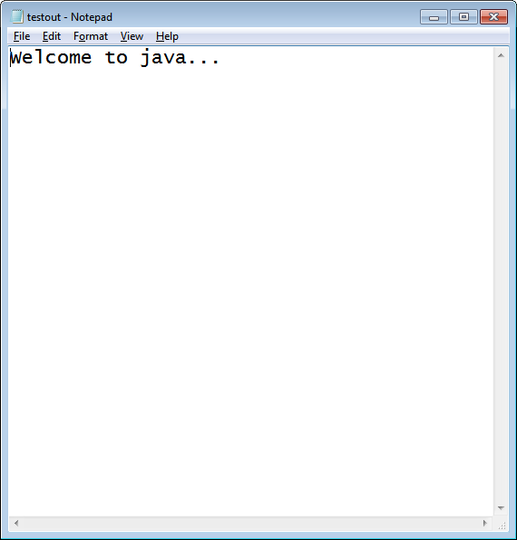
After executing the above program, you will get a single character from the file which is 87 (in byte form). To see the text, you need to convert it into character.

Slide 18
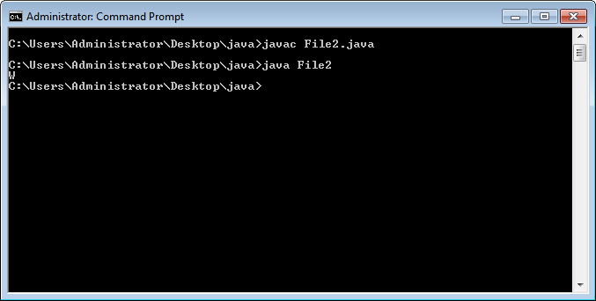

Slide 19
package com.javatpoint;
import java.io.FileInputStream;
public class DataStreamExample {
public static void main(String args[]){
try{
FileInputStream fin=new FileInputStream("D:\\testout.txt");
int i=0;
while((i=fin.read())!=-1){
System.out.print((char)i);
}
fin.close();
}catch(Exception e){System.out.println(e);}
}
}

Slide 20
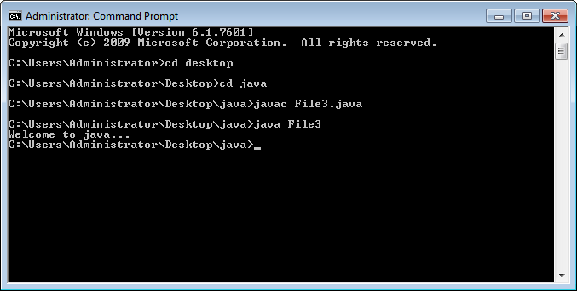

Slide 21
Example: BufferedOutputStream
import java.io.*;
public class BufferedOutputStreamExample{
public static void main(String args[])throws Exception{
FileOutputStream fout=new FileOutputStream("D:\\testout.txt");
BufferedOutputStream bout=new BufferedOutputStream(fout);
String s="Welcome to java.";
byte b[]=s.getBytes();
bout.write(b);
bout.flush(); //flushes the data of one stream and send it into another
bout.close();
fout.close();
System.out.println("success");
}
}
Output:
Success
testout.txt
Welcome to java

Slide 22
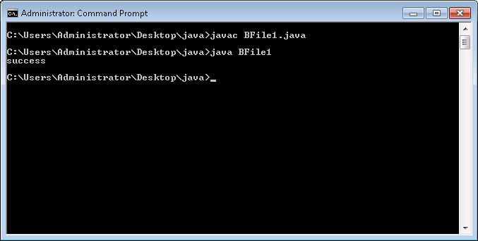

Slide 23
Example: BufferedInputStream
import java.io.*;
public class BufferedInputStreamExample{
public static void main(String args[]){
try{
FileInputStream fin=new FileInputStream("D:\\testout.txt");
BufferedInputStream bin=new BufferedInputStream(fin);
int i;
while((i=bin.read())!=-1){
System.out.print((char)i);
bin.close();
fin.close();
}catch(Exception e){System.out.println(e);}
}
}

Slide 24
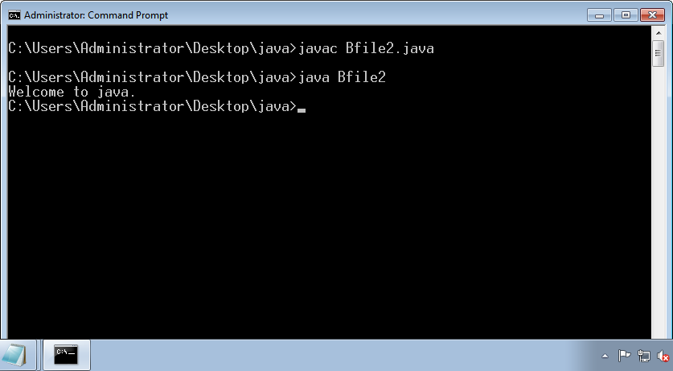

Slide 25
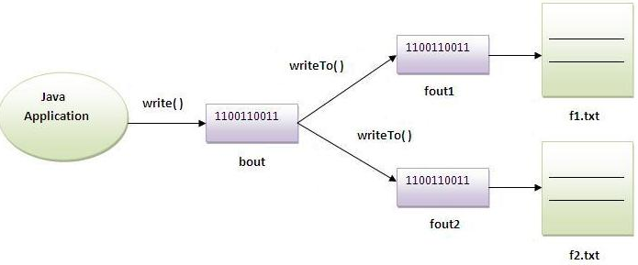

Slide 26
Example of Java ByteArrayOutputStream
package com.javatpoint;
import java.io.*;
public class DataStreamExample {
public static void main(String args[])throws Exception{
FileOutputStream fout1=new FileOutputStream("D:\\f1.txt");
FileOutputStream fout2=new FileOutputStream("D:\\f2.txt");
ByteArrayOutputStream bout=new ByteArrayOutputStream();
bout.write(65);
bout.writeTo(fout1);
bout.writeTo(fout2);
bout.flush();
bout.close();//has no effect
System.out.println("Success...");
}
}

Slide 27
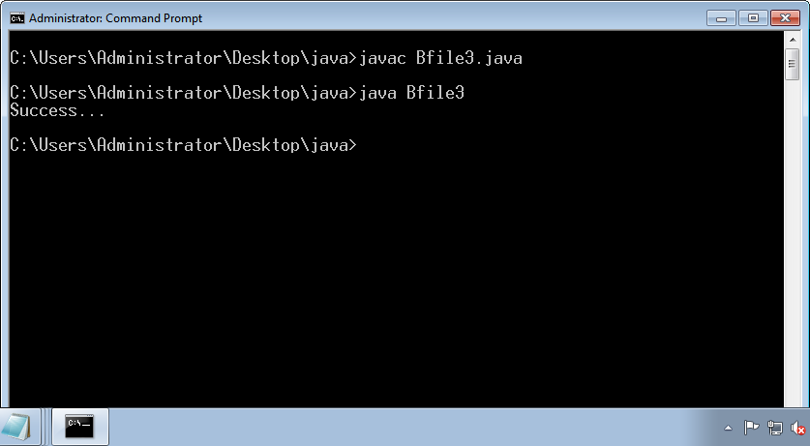

Slide 28
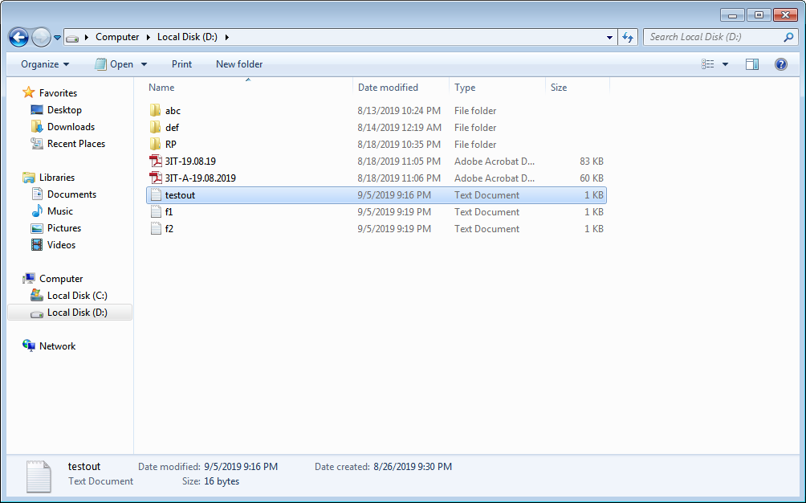

Slide 29
Example of Java ByteArrayInputStream
import java.io.*;
public class ReadExample {
public static void main(String[] args) throws IOException {
byte[] buf = { 35, 36, 37, 38 };
// Create the new byte array input stream
ByteArrayInputStream byt = new ByteArrayInputStream(buf);
int k = 0;
while ((k = byt.read()) != -1) {
//Conversion of a byte into character
char ch = (char) k;
System.out.println("ASCII value of Character is:" + k + "; Special character is: " + ch);
}
}
}

Slide 30
